Slide 1

XPERT INTEGRATED SERVICES PRIVATE LIMITED
_____You Choose ….We Clean ….

Slide 2
Xpert….
An enterprise with a unique model of using Facility Management Services to provide livelihood for the needy without exploitation and with full benefits.
Committed to empowering people at the bottom of the pyramid through employment and empowerment.

Slide 3
Mission Statement….
We believe in providing complete services to our customer’s.
Our staffs play a key role to our success as they give optimum performance in their job and interaction with customer’s.

Slide 4
Summary….
Our model of delivery bridges the gap between the HR / CSR aspirations of the client and their Operations / Administration / Procurement departments’ expectations.
We work in partnership mode, making it possible to achieve our objectives without compromising on the demands of the business.

Slide 5
Why Out Source….?
Making the decision to outsource your facility services is an important strategic business decision that can reap many benefits. Listed below are just three reasons why you should consider outsourcing your facility service.
1. Redeploy Assets / Resources: This allows the client to focus on core business activity the greatest benefit of outsourcing is operational, continuity, risk management, and staffing controls.
2. Cost and Efficiency Savings: Outsourcing can save money by allowing you to establish a budget that gives complete and accurate control of those functions that are not core to your business, thereby creating a fixed expense instead of a variable expense which is easier to manage and plan.
3. Partnership: By outsourcing your janitorial, custodial, and building maintenance needs, you gain a trusted, respected, and proven leader in the business. You will be able to leverage our knowledge and experience to save money and time.

Slide 6
Client Expectations….
  In the outsourced industry client expectations are invariably restricted to:
  Standardized quality of service.
  Least amount of disruptions.
  Low need for interventions.
  Statutory compliances are a major concern. Clients would demand:
  Total protection from defaults and claims on the principal employer.
  Total transparency and support at times of inspection and investigation.
  Liaisoning with Government authorities for STPI Certification,
  Electrical duty exemption & refund.
  Co-ordinations with authorities for electrical inspections.
  Liaisoning with Government authorities, electricity supplier for any kind of registration and audits.

Slide 7
Soft Services….
          Housekeeping : Bathroom Sanitizing / Carpet / Chair /Sofa Shampooing
          Front Office Assistance / Lift Operators / Valet & Parking Management
          Helpdesk Management
          Guest House Management
          Hospitality (Pantry) Services
          Mailroom Management
          Home Care

Slide 8
ELECTRICAL…
New Installation of all Primary & Secondary points, panel fitting, dressing, testing maintenance labelling Electrical maintenance Lighting Fitting DB maintenance UPS Checks Panel maintenance DG maintenance Engineering O & M Services Operation and maintenance of all types of electrical installation such as HT/LT Panels, ATS, VCBS, Transformers, HVAC, Chillers, AHU,s, UPS,PAC,s, All circuit Breakers, Fire panels, All types of panels, DB,s, etc. Including preventive predictive and breakdown maintenance.
Operation and maintance of diesel Generator (DG Set), AMF panels, DG Synchronization Operation & Monitoring of BMS system, Access Control, Fire Alarm, Fire hydrant system, CCTV, Water Leak Detection system, Vesda system, Public Address System. Operation and maintenance of all kind of substations such as 11kv,33kv, 220kv, 400/220kv, power grid substation.
Operation and maintenance of pharmaceutical & production industry installation such as air compressors, oxygen plants, steam boilers, cooling towers, water chillers, brine chillers, nitrogen plants, RO Plants, ETP/STP/WTP etc.
Operation and maintenance of MSU’s, WLD, FM 200 Gas suppression Systems & Vesda Systems, DC (-48V) Rectifier Plant operation, DC Power plant, MSC. (Core Network/Switching) etc.
Annual electrical inspectorate periodical inspection works annual shutdowns maintenance, earth pits, calibration works. Etc. operation and maintenance of solar power plant.

Slide 9
HVAC Operation…
Operations & Maintenance of Chillers.
O & M of AHU units.
O & M of Packaged Air Conditioner units.
O & M of Cassette AC Units.
O & M of Window AC units.
O & M of Split AC units.
O & M of Server room AC.
Monitoring of VFDs, VMA.
Regular Checks on dampers.

Slide 10
Fire & Safety System…
Installation, Smoke Access, CCTV, Intrusion, Rodent, WLD, Hooter, MCP, Integration, Public Addressable, Operation Maintenance & FAS, Sprinkler, Smoke detector, Novac, VESDA, Fire Extinguisher.
Interiors Work Carpentry – New Creation of Work Station, Meeting Table , Glass Partition. Aluminium Partition, Soft Board Creation and all Repairing Carpentry. Civil – Brick Wall Work, Plastering, Leakage Treatment, Tiles, Flooring etc.
Plumbing – Installed & repair of domestic lines, Wash room, WC’s, Urinal, Basin, Bottle trap.
Security and Surveillance Solution
Man Guarding Services
Electronic Security Solutions
Cash Management and Logistics

Slide 11
Annual maintance contract (AMCI)…
Annual Maintenance Contract of split AC’s Ductable AC’s, Air-conditioning Plants.
AMC’s of low side HVAC Systems.
AMC’s of Electrical System, Breakers, Panels, Diesel Generators’ Transformer service sing & other electrical installations.
Plumbing Installation and water supply system.
Carpentry Services.

Slide 12
ON Call Services…
We offer On Call Services to small sized offices
Extensive on Call services are provided to residential towers, flats, guest houses & commercial offices.
On Call services are also offered for shutdown & breakdown maintenance.

Slide 13
Data Centre Maintenance Services…
Regular operations and maintenance on 24X7 Days, that includes.
System Performance Checks.
System Capacity Tracking.
Overall operation and maintenance of all electrical, Mechanical, and HVAC Equipment within the Data Centre and Controlled
Temperature management, supporting mission-critical servers and must maintaining better than 99.999% uptime.
Dedicated stand by diesel generators O & M switchgear, UPS, PDUs, wet cell batteries and associated systems, CRAC, Centrifugal chillers, cooling towers/ water chemical system, air handlers and associated systems, pumps & motors.
Maintenance tasks to include filter changes, battery system.
PMs’ & Rack PDU & Rack ATS replacements.
Mechanical system (RTU, Humidifier, A/C), Fire alarm and suppression systems, building control systems and preventative maintenance programs for call.
Other service Audio Video EPABX.

Slide 14
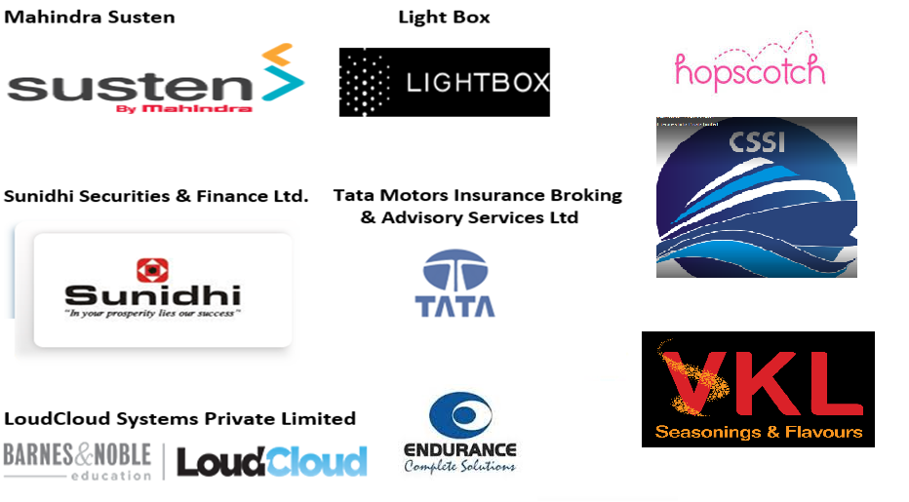
Client List….

Slide 15
Client List :-
          Relievi India Pvt. Ltd.
          Paramount General Hospital & I C C U
          ESR Advisors India Pvt. Ltd.
          G5A Foundation For Contemporary Culture
          True Fit Development India Pvt. Ltd
          Haikujam Technologies Private Limited
          Leap India Private Limited
          Reed Exhibitions
          Brickworks Ratings India Pvt Ltd
          Scor SE India

Slide 16
Registration Certificates….
SHOP & ESTABLISHMENT : 762167105 / COMMERCIAL II
PAN No : AAACX3136B
TAN No : MUMX00777A
P.F. Regn. No : KDMAL2054099000
ESIC Regn. No : 35000457350001099
P.T Regn No : 27601734075P
GST No : 27AAACX3136B1ZQ

Slide 17
Connect with us….
Xpert Integrated Services Private Limited
Registered Office Address:-
Office No.006, Apollo Complex,
R K Singh Marg, Off Parsi Panchayat Road,
Near Apollo Arcade,
Andheri – (East)
Mumbai – 400 069.
Contact Tel. No. +91 022 6696 4333
Mobile No.: +91 96 1991 3646
E-Mail ID :- francis.fernandes@xpertintegrated.in
sales@xpertintegrated.in
Web :- www.xpertintegrated.in

